Slide 1
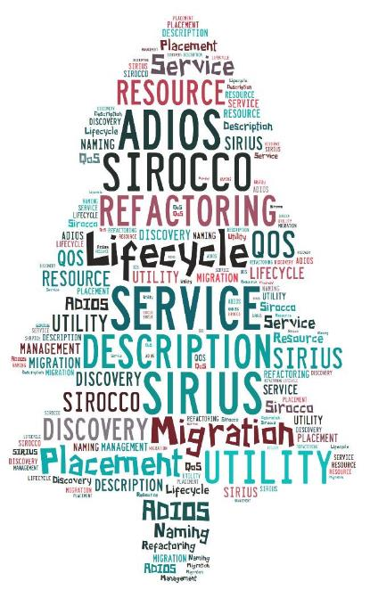
SCIENCE-DRIVEN DATA MANAGEMENT FOR MULTI-TIERED STORAGE February 17, 2016 ECP
S. Klasky ORNL, GT U. Tenn., NCSU
H. Abbasi, Q. Liu, F. Wang ORNL
J. Lofstead, M. Curry, L. Ward Sandia
M. Parashar Rutgers
C. Maltzahn UCSC
M. Ainsworth Brown, ORNL

Slide 2
40 minute presentation: Cover the following
The goals of your project and its current status
Do you release your software as open source?
Do you have DOE/NNSA users of your software?
Have facilities, vendors, or ISVs picked up your software?
What is the support model for your software?
Are there any applications in particular that the outcomes of your project are targeting?
The specific ties to identified requirements of the applications, other software components?
Your plan for ensuring that the developed software technologies be mature enough to be part of the software stack on exascale systems expected to be selected in 2019 and installed in 2023?
What do you feel are the key challenges posed and opportunities offered by exascale systems for your specific area?
What is the R&D that you would like to carry out within the ECP?
What research remains for your project’s outcomes to benefit key DOE applications?
How would the proposed activities build on the research you have been carrying out with ASCR Research funding?
What are the proposed activities that you believe would contribute to the ECP?
Your roadmap/timeline for maturing the software technologies and deploying them on exascale platforms, with a few intermediate milestones or decision points (forks in the roadmap). The timeline is of particular importance in selecting what the ECP will include in the development plans.
Highlight your activities that would help DOE exascale apps achieve ECP performance, efficiency and resilience performance goals on 2023 hardware and system architectures

Slide 3

Outline
Motivation
SIRIUS Building Blocks
Data Description
Auditing
Data Refactoring
Metadata Searching
Fuzzy Predictable Performance

Slide 4
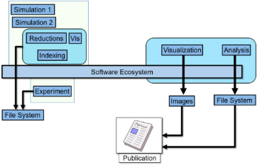
Where Do We Spend Our Time in Science?
Goals
Accelerate this process
Make the process predictable
Make the process adaptable
Make the process scalable as the complexity increases
Make the software easy-to-use
Observation
Most of the time is spent in managing, moving, storing, retrieving , and turning the science data into knowledge
Notes:
----- Meeting Notes (4/30/13 17:08) -----
step 3: rename Analysis to Analytics to connect back to the trendy buzzword

Slide 5
SIRIUS Story
Applications at Exascale can dump out a large amount of analysis data.
Storage systems may not have the capacity or performance to sustain large datasets in the future
We need to refactor data so that “important” datasets can be prioritized
E.g., precision-based, resolution-based, feature-based, and etc.
Challenges:
How can the middleware and storage system understand refactored data? Data description is needed.
Need scalable metadata searching to find refactored data
The interplay between data refactoring and predictable storage performance.

Slide 6
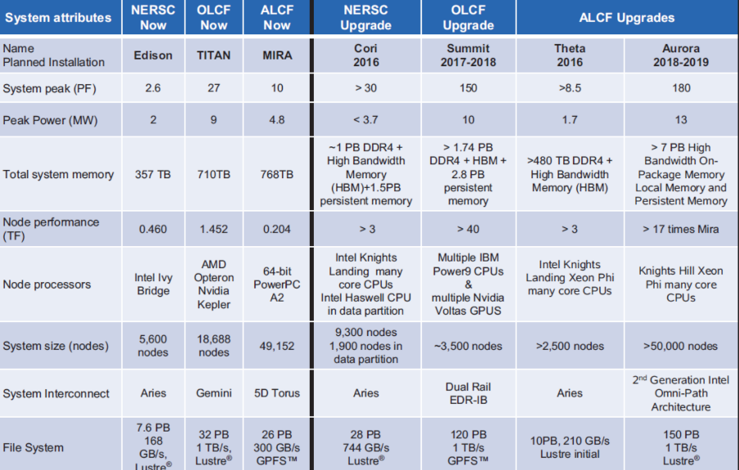
Next Generation DOE computing

Slide 7
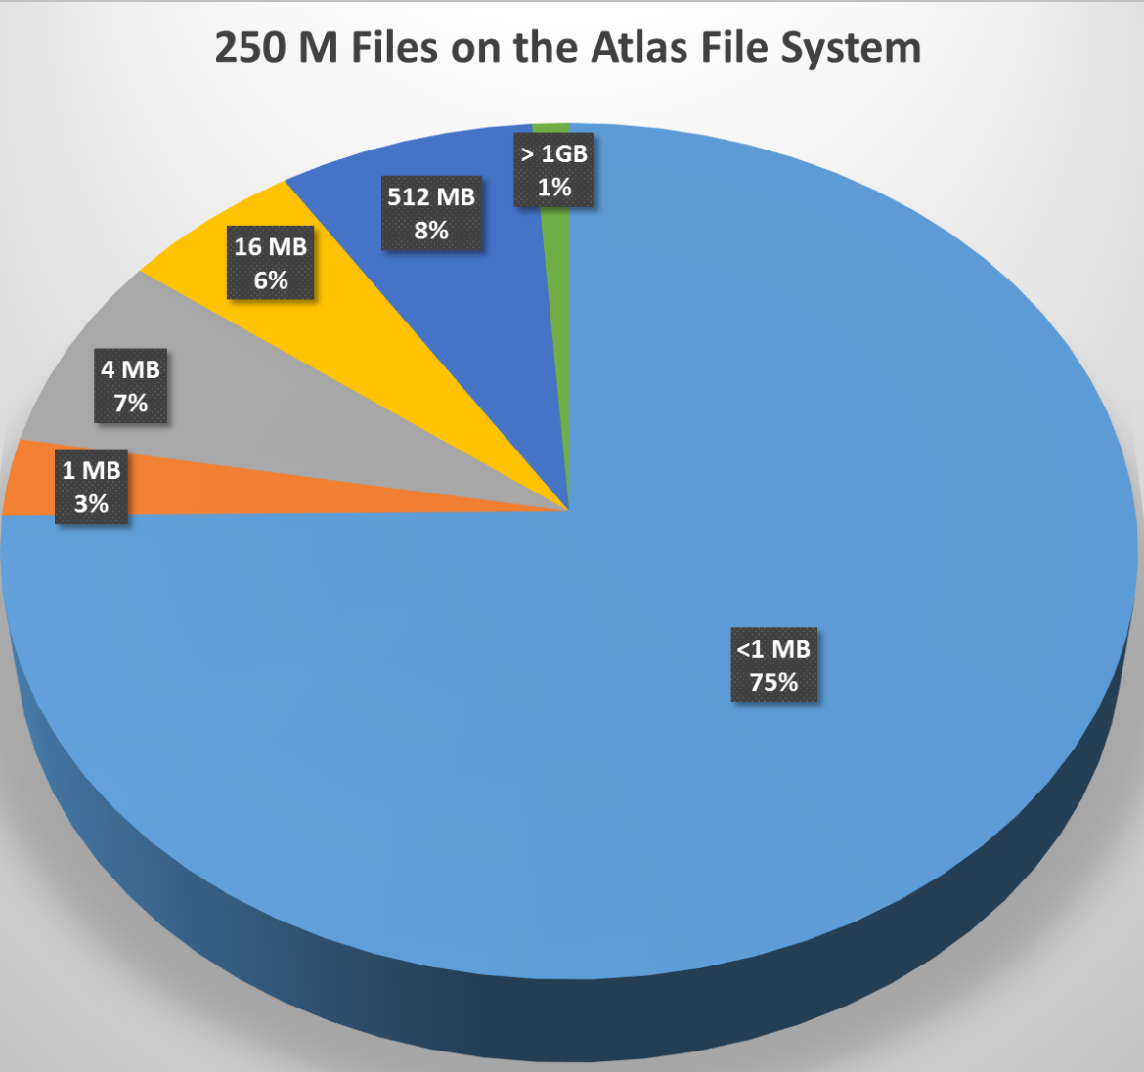
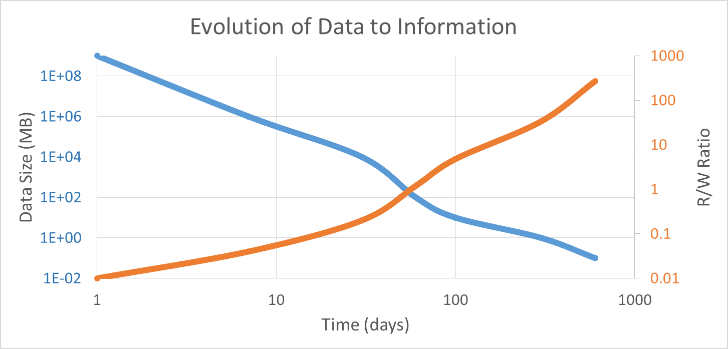

Abstractions across File System to DB
Typical FS workload
Typical DB workload
RAM
NVRAM
Remote NVRAM
Parallel Storage System
Tape (HPSS)
Campaign Storage
SIRIUS API to manage data across all of the storage/DB layers
DB

Slide 8
Principles
Principle 1: A knowledge-centric system design that allows user knowledge to define data policies
Today SSIO layers are written in a stove-pipe fashion, and quite often do not allow optimizations to take place
Re-design the layers in a highly integrated fashion where users place their intentions into the system and actions will statically and dynamically take place to optimize for the system and for individual requests
Principle 2: Predictable performance and quality of data in the SSIO layers need to be established so science can be done on the exascale systems in a more efficient manner
Without predictable performance, not only can the runs be slowed down because of contentions on shared resources, but also it affects key science decisions

Slide 9

Outline
Motivation
SIRIUS Building Blocks
Data Description
Auditing
Data Refactoring
Metadata Searching
Fuzzy Predictable Performance

Slide 10
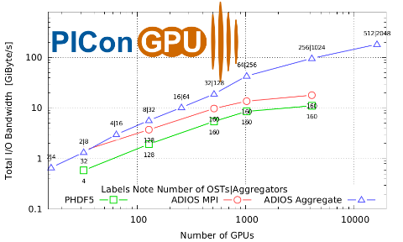

ADIOS
An I/O abstraction framework
Provides portable, fast, scalable, easy-to-use, metadata rich output
Choose the I/O method at runtime
Abstracts the API from the method
Need to provide solutions for “90% of the applications”
Astrophysics
Climate
Combustion
CFD
Environmental Science
Fusion
Geoscience
Materials Science
Medical: Pathology
Neutron Science
Nuclear Science
Quantum Turbulence
Relativity
Seismology
Sub-surface modeling
Weather
Klasky, S. Ethier, Z. Lin, K. Martins, D. McCune, R. Samtaney, Grid-based parallel data streaming implemented for the gyrokinetic toroidal code in Proceedings of the 2003 ACM/IEEE conference on Supercomputing, ACM, p. 24.
J. F. Lofstead, S. Klasky, K. Schwan, N. Podhorszki, C. Jin, Flexible io and integration for scientific codes through the adaptable io system (adios) in Proceedings of the 6th international workshop on Challenges of large applications in distributed environments, ACM, pp. 15–24.
J. Lofstead, F. Zheng, S. Klasky, K. Schwan, Input/output apis and data organization for high performance scientific computing in Petascale Data Storage Workshop, 2008. PDSW’08. 3rd, IEEE, pp. 1–6.
J. Lofstead, F. Zheng, S. Klasky, K. Schwan, Adaptable, metadata rich IO methods for portable high performance IO in Parallel & Distributed Processing, 2009. IPDPS 2009. IEEE International Symposium on, IEEE, pp. 1–10.
H. Abbasi, J. Lofstead, F. Zheng, K. Schwan, M. Wolf, S. Klasky, Extending i/o through high performance data services in Cluster Computing and Workshops, 2009. CLUSTER’09. IEEE International Conference on, IEEE, pp. 1–10.
Q. Liu, J. Logan, Y. Tian, H. Abbasi, N. Podhorszki, J. Y. Choi, S. Klasky, R. Tchoua, J. Lofstead, R. Oldfield, et al.. Hello ADIOS: the challenges and lessons of developing leadership class I/O frameworks. Concurrency and Computation: Practice and Experience 2014, 26, 1453–1473.
http://www.nccs.gov/user-support/center-projects/adios/

Slide 11
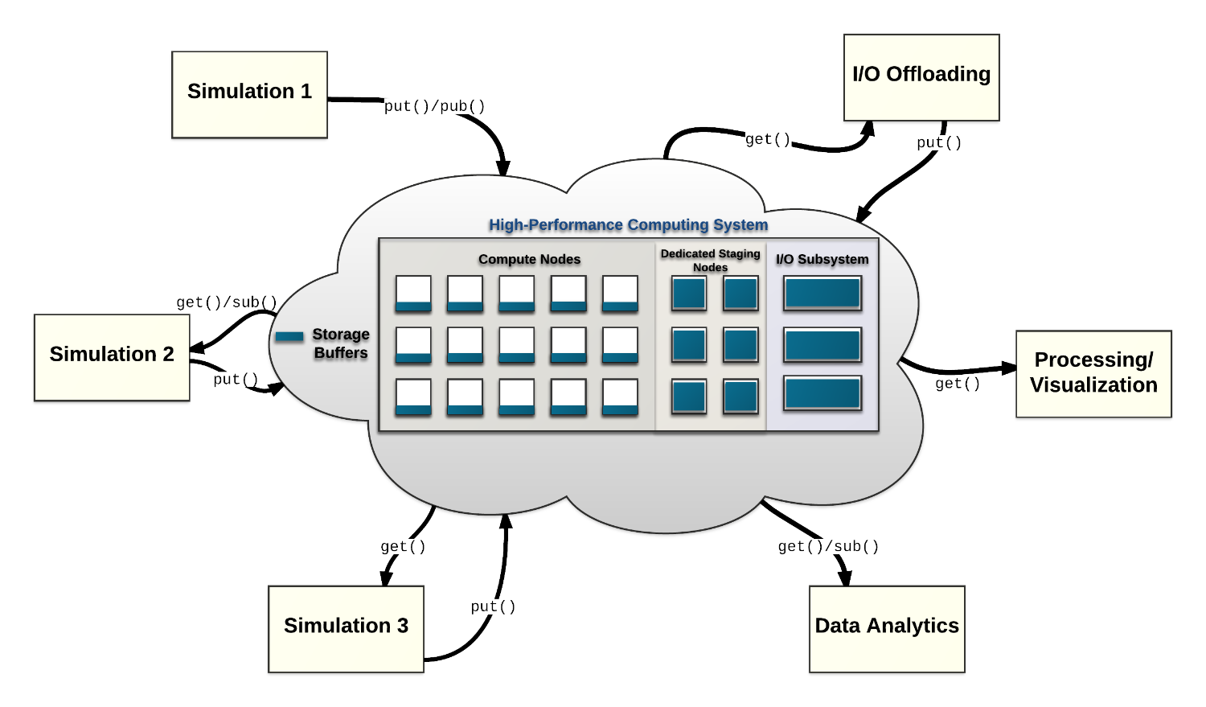
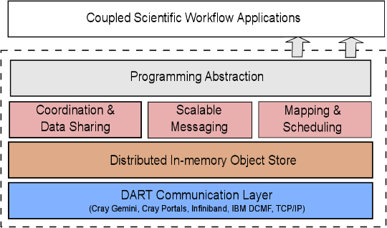
DataSpaces – Rutgers
The DataSpaces Abstraction
Virtual shared-space programming abstraction
Simple API for coordination, interaction and messaging
Distributed, associative, in-memory object store
Online data indexing, flexible querying
Autonomic cross-layer runtime management
Hybrid in-situ/in-transit execution
Adaptive (utility driven) data object placement and migration
Efficient, high-throughput/low-latency asynchronous data transport

Slide 12
Object Storage
Light Weight File System-inspired philosophy
Clients bring/opt-in to services they require
Naming, locking, distributed transactions
Peer-to-peer inspired design
Ephemeral, diverse servers and clients
Data and location(s) are decoupled
Addressed systems
Sirocco (Sandia) http://www.cs.sandia.gov/Scalable_IO/sirocco/
Full control from ownership, in development technology
Ceph (RedHat)
Mature, production system with special attention required to address HPC workloads
DAOS (Intel)
Next generation Lustre with strong commercial and DOE support, still under development

Slide 13
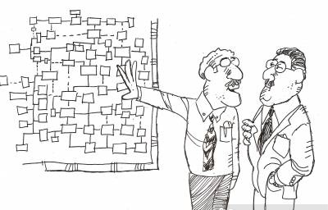
Outline
Motivation
SIRIUS Building Blocks
Data Description
Auditing
Data Refactoring
Metadata Searching
Fuzzy Predictable Performance

Slide 14
Data Refactoring
Data needs to be refactored so that more important data can be prioritized, e.g., being placed on the higher tier on the storage systems.
Challenges:
To understand the cost associated with refactoring data, in terms of CPU cycles, extra memory consumed, and communication.
Does the refactoring affect the fidelity of the applications? If so, how much?
After data is refactored, how do we map it to the storage hierarchy? How do we enforce policy?

Slide 15
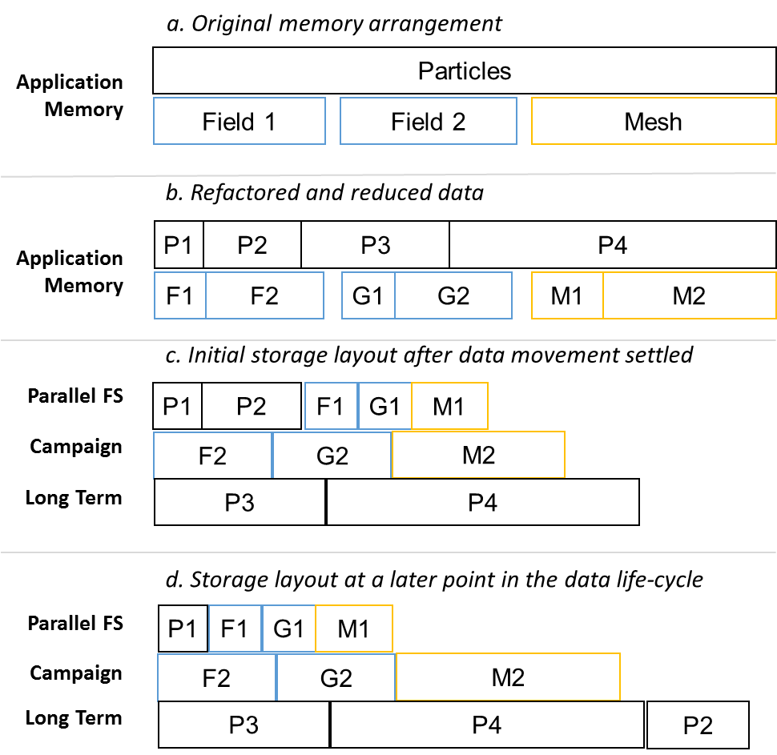
Data Utility
Describes how long a data chunk will live at a level of the storage hierarchy
Utility is a broad description
Spatial or temporal utility of data
Utility based on in-data features
Utility based on statistical features
Utility has a large component from the user and the use case
Experimental design factors in here
Solving a specific scientific problem => specific data utility function
API for ingesting user preferences and combining with historical provenance
Dynamic utility for online analysis/visualization use cases
e.g. The utility of F1 may be defined more explicitly as, for example, (priority=1, (time-NVRAM=8 hours, time-PFS=30 days, time-CAMPAIGN=100 days, time-TAPE=1000 days),
(priority=2, (time-NVRAM=1 hours, time-PFS=4 days, time-CAMPAIGN=100 days, time-TAPE=300 days).

Slide 16
Data Refactoring and Utility Functions
Need to explore what and where the computation will occur
Flexibility in location based on past work
Flexibility in which operation to perform on which chunk of data
Code generation or code containers are potential study targets
Maintaining relationship between data chunks
Carry attributes from generation to consumption and feedback into a utility computation

Slide 17
Utility-driven Data Placement
Goal: Determine placement of data objects vertically across different levels of the memory hierarchy, e.g., SSD or DRAM, and horizontally at different staging nodes
Utility quantifies the relative value of data objects based on anticipated data read patterns
Utility based on data access patterns (monitored and learnt at runtime) and the location of the application and staging nodes within the system network topology
For example, data objects with higher data utility are placed closer to the computing nodes accessing it
Exploring Data Staging Across Deep Memory Hierarchies for Coupled Data Intensive Simulation Workflows. T. Jin, F. Zhang, Q. Sun, H. Bui, M. Romanus, N. Podhorszki, S. Klasky, H. Kolla, J. Chen, R. Hager, C. Chang, M. Parashar. IEEE IPDPS'15, May 2015
Adaptive Data Placement For Staging-Based Coupled Scientific Workflows. Q. Sun, T. Jin, M. Romanus, H. Bui, F. Zhang, H. Yu, H. Kolla, S. Klasky, J. Chen, M. Parashar. ACM/IEEE SC'15, Nov. 2015.

Slide 18
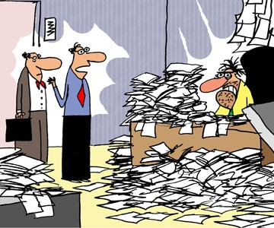
Outline
Motivation
SIRIUS Building Blocks
Data Description
Auditing
Data Refactoring
Metadata Searching
Fuzzy Predictable Performance

Slide 19
New techniques for “Data Intensive Science”
AUDITOR: An additional “simulation” whose purpose is to monitor the fine scale simulation and initiate appropriate actions when anomalies are detected
Examples
Trigger a: checkpoint, roll-back, local change in a function, …
Not confined to stability issues because it will always reset
Can allow data regeneration cheaply
Basic quantities in Information Theory
Data stream S and for x ∈ S let P_{r}(X=x) = p_{x} ∈ [0,1]
Shannon Information Content: h(x) = - log₂ p_{x}
Entropy H(S) = - Σ p_{x} log₂ p_{x}
Noisy/random data has HIGH ENTROPY

Slide 20
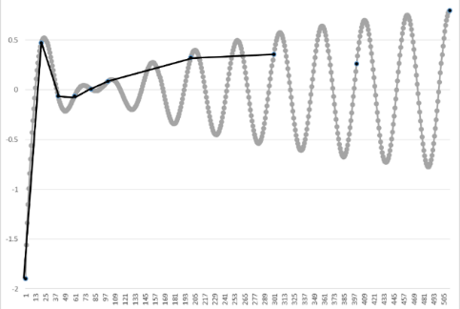
Current practices of today
Linear interpolation
Want to write data every n^{th} timestep
Because of the Storage and I/O requirements users are forced to writing less
Common practice is to write data at every m^{th} timestep, stride = M
If the users reconstruct their data, u(t), at the n^{th} timestep, they need to interpolate between the neighboring timesteps
Φ_{M}(u) = interpolant on coarser grid (stride M), reduce storage my 1/M
Assume (C=constant depending on the complexity of the data)
Original storage cost = 32*N bits (floats)
New storage cost = 32*N/M bits + { 23 – log₂ (C M² Δt²)}N
Ratio = (1/M – 1/16 log₂ M) – 1/16 log₂ Δt + constant
u-ϕ_{M}(u) = O(M² Δt²) : 2nd order interpolation
Cost to store ϕ_{M} + Cost to store mantissa of u- ϕ_{M}(u)
Notes:
8 bits in a byte, 4 bytes per word, N words, M=stride

Slide 21

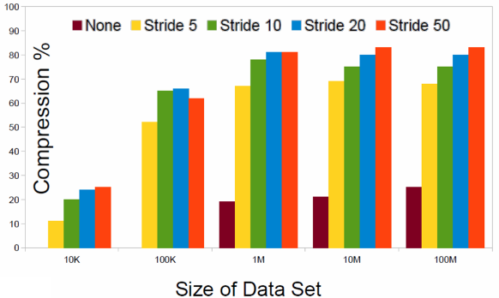
Compression with an interpolation auditor
Linear interpolation (LA) is the auditor
If we look at 10MB output, with a stride of 5
Total output = 50MB for 5 steps
10 MB, if we output 1 step, 43MB “typical lossless compression”, 18MB, using linear auditing but lossless
Investigating adaptive techniques
Stride | 1 step (MB) | lossless compression (MB) | Linear Audit (MB) | Total Data in 50 steps, typical compression | Total data in 50 steps in LA
5 | 10 | 43 | 18 | 430 | 180
10 | 10 | 85 | 25 | 850 | 125
20 | 10 | 170 | 40 | 1700 | 100
50 | 10 | 425 | 100 | 4250 | 100

Slide 22
Other types of auditors
The key to better auditors is to understand what you are simulating/observing
Use a reduce model
Use less resolution
Use a linear equation for short spatial/temporal regions
And other ways to refactor
Precision based re-organization
Frequency based re-organization - Wavelets
More knowledgeable auditors
Cost of data re-generation vs. data storage/ retrieval
Storage becomes more than a stream of bytes
Data + Code + workflow

Slide 23
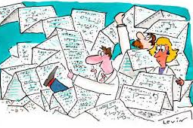
Outline
Motivation
SIRIUS Building Blocks
Data Description
Auditing
Data Refactoring
Metadata Searching
Fuzzy Predictable Performance

Slide 24
Data Descriptions
Now that data is refactored, how do we describe/annotate data so that they can be discovered?
To capture application knowledge and communicate them to middleware/storage
Data utility
Relationships between datasets
Semantics
To specify user requirements
QoS: bandwidth, latency
Policy: E.g., where and how long should my data stay on a storage layer

Slide 25
Conceptual APIs
sirius_init
sirius_finalize
sirius_open -intent
sirus_close -intent
sirius_set_refactor -refactoring_fn
sirius_get_refactor. -refactoring_fn
sirius_sched_write –utility
sirius_sched_read -utility
sirius_set_deadline –deadline, fuzziness
sirius_est_write -time_est, confidence
sirius_est_read -time_est, confidence
sirius_perform_write
sirius_perform_read -deadline, fuzziness
How does the system reassemble the pieces after the data has been refactored?
Re-factoring might mean combing different data chunks together, and this takes time!

Slide 26

Outline
Motivation
SIRIUS Building Blocks
Data Description
Auditing
Data Refactoring
Metadata Searching
Fuzzy Predictable Performance

Slide 27
Challenges in metadata searching
Storage devices rather than a file system: no built-in metadata operations as part of IO
Distributed pieces EVERYWHERE
Resilience copies
Storage devices come and go
Performance characteristics can vary considerably
Pick a variety of storage targets based on data “importance”
Different data “compression” on different data pieces
Try to “guarantee” performance
Need to consider decompression/regeneration time if multiple versions exist
Enhance placement decision based on predicted future use
Based on tracking previous use (which needs to be tracked somehow)

Slide 28

Outline
Motivation
SIRIUS Building blocks
Data Description
Auditing
Data Refactoring
Metadata searching
Fuzzy predictable performance

Slide 29
The End-to-End Data Path
Titan Compute Cluster
440 I/O Router
18,688 compute node
and 299,008 cores
Storage Servers (OSS), 288 Dell servers, 64GB RAM each
SION Infiniband Network: 1600 ports, 56 Gbit/sec
Enterprise Storage System: 36 DDN12K-40 controller pairs

Slide 30
Autonomic Runtime Optimization
Autonomic Objective (AO):
A requirement/objective/goal defined by the user
E.g. minimize data movement, optimize throughput, etc.
Autonomic Objectives (AO)
Decide
Autonomic Policy (AP)
A rule that defines how the objectives should be achieved, i.e., which mechanisms should be used
E.g. use a specific data placement adaptation to minimize data movement , etc.
Autonomic Policies (AP)
Achieve
Autonomic Mechanism (AM)
An action that can be used to achieve an AO
E.g. use topology-aware and access-pattern driven data placement to minimize data movement, etc.
Specify/Utilize
Autonomic Mechanisms (AM)

Slide 31
Challenges
Scalable admission control
Need scalable control plane (leverage existing work on causal metadata propagation and online sampling for latency/error trade-offs)
Resource-specific schedulers to make performance of resource predictable
Example: read/write separation at flash devices
Online sampling to provide quick latency/resolution trade-offs
Without significantly interfering with ongoing workload

Slide 32
Summary
Sirius is attempting to redefine I/O based on key findings
POSIX-compliant block interface does not give the system enough information to fully optimize
Data is too big to keep in one place and current systems purge data without user intervention
Variability is too large, and users are not in control of their data
Scientific Data is not random data
There is content to the data
Auditing calculations to prioritize, reduce data sizes but keep the information is critical to reduce the time of understanding

Slide 33
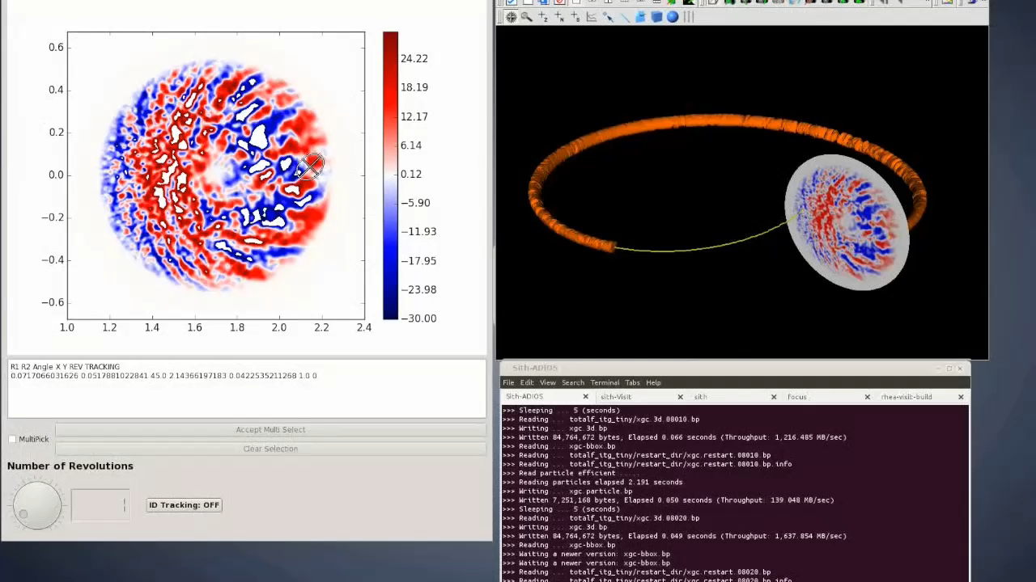

Slide 34
Current Status
SIRIUS will be open source since the beginning of the project
SIRIUS users:
DOE Fusion XGC1, GTC, and etc, as initial users to drive the development
Long term support of SIRIUS will leverage various funding sources include DOE SSIO, DOE SciDAC, OLCF, and etc.
SIRIUS is driven by the fact that many DOE applications generates large amounts of analysis data that need to be mapped to storage hierarchy efficiently.

Slide 35
Current Status
To ensure that SIRIUS will be ready for exascale software stack, we will identify and resolve major research challenges in the next 3 years, and leverage ECP as well as other future projects (e.g., SciDAC, LCF), and work closely with applications to harden the software.
SIRIUS will build upon key capabilities that were/have been funded by ASCR. These include ADIOS, DataSpaces, and Sirocco and DAOS object storage. These capabilities resulted in production software that have been used by production science. SIRIUS will further build upon these successes and further integration and advance data storage and analysis capabilities.

Slide 36

Questions

